Slide 1
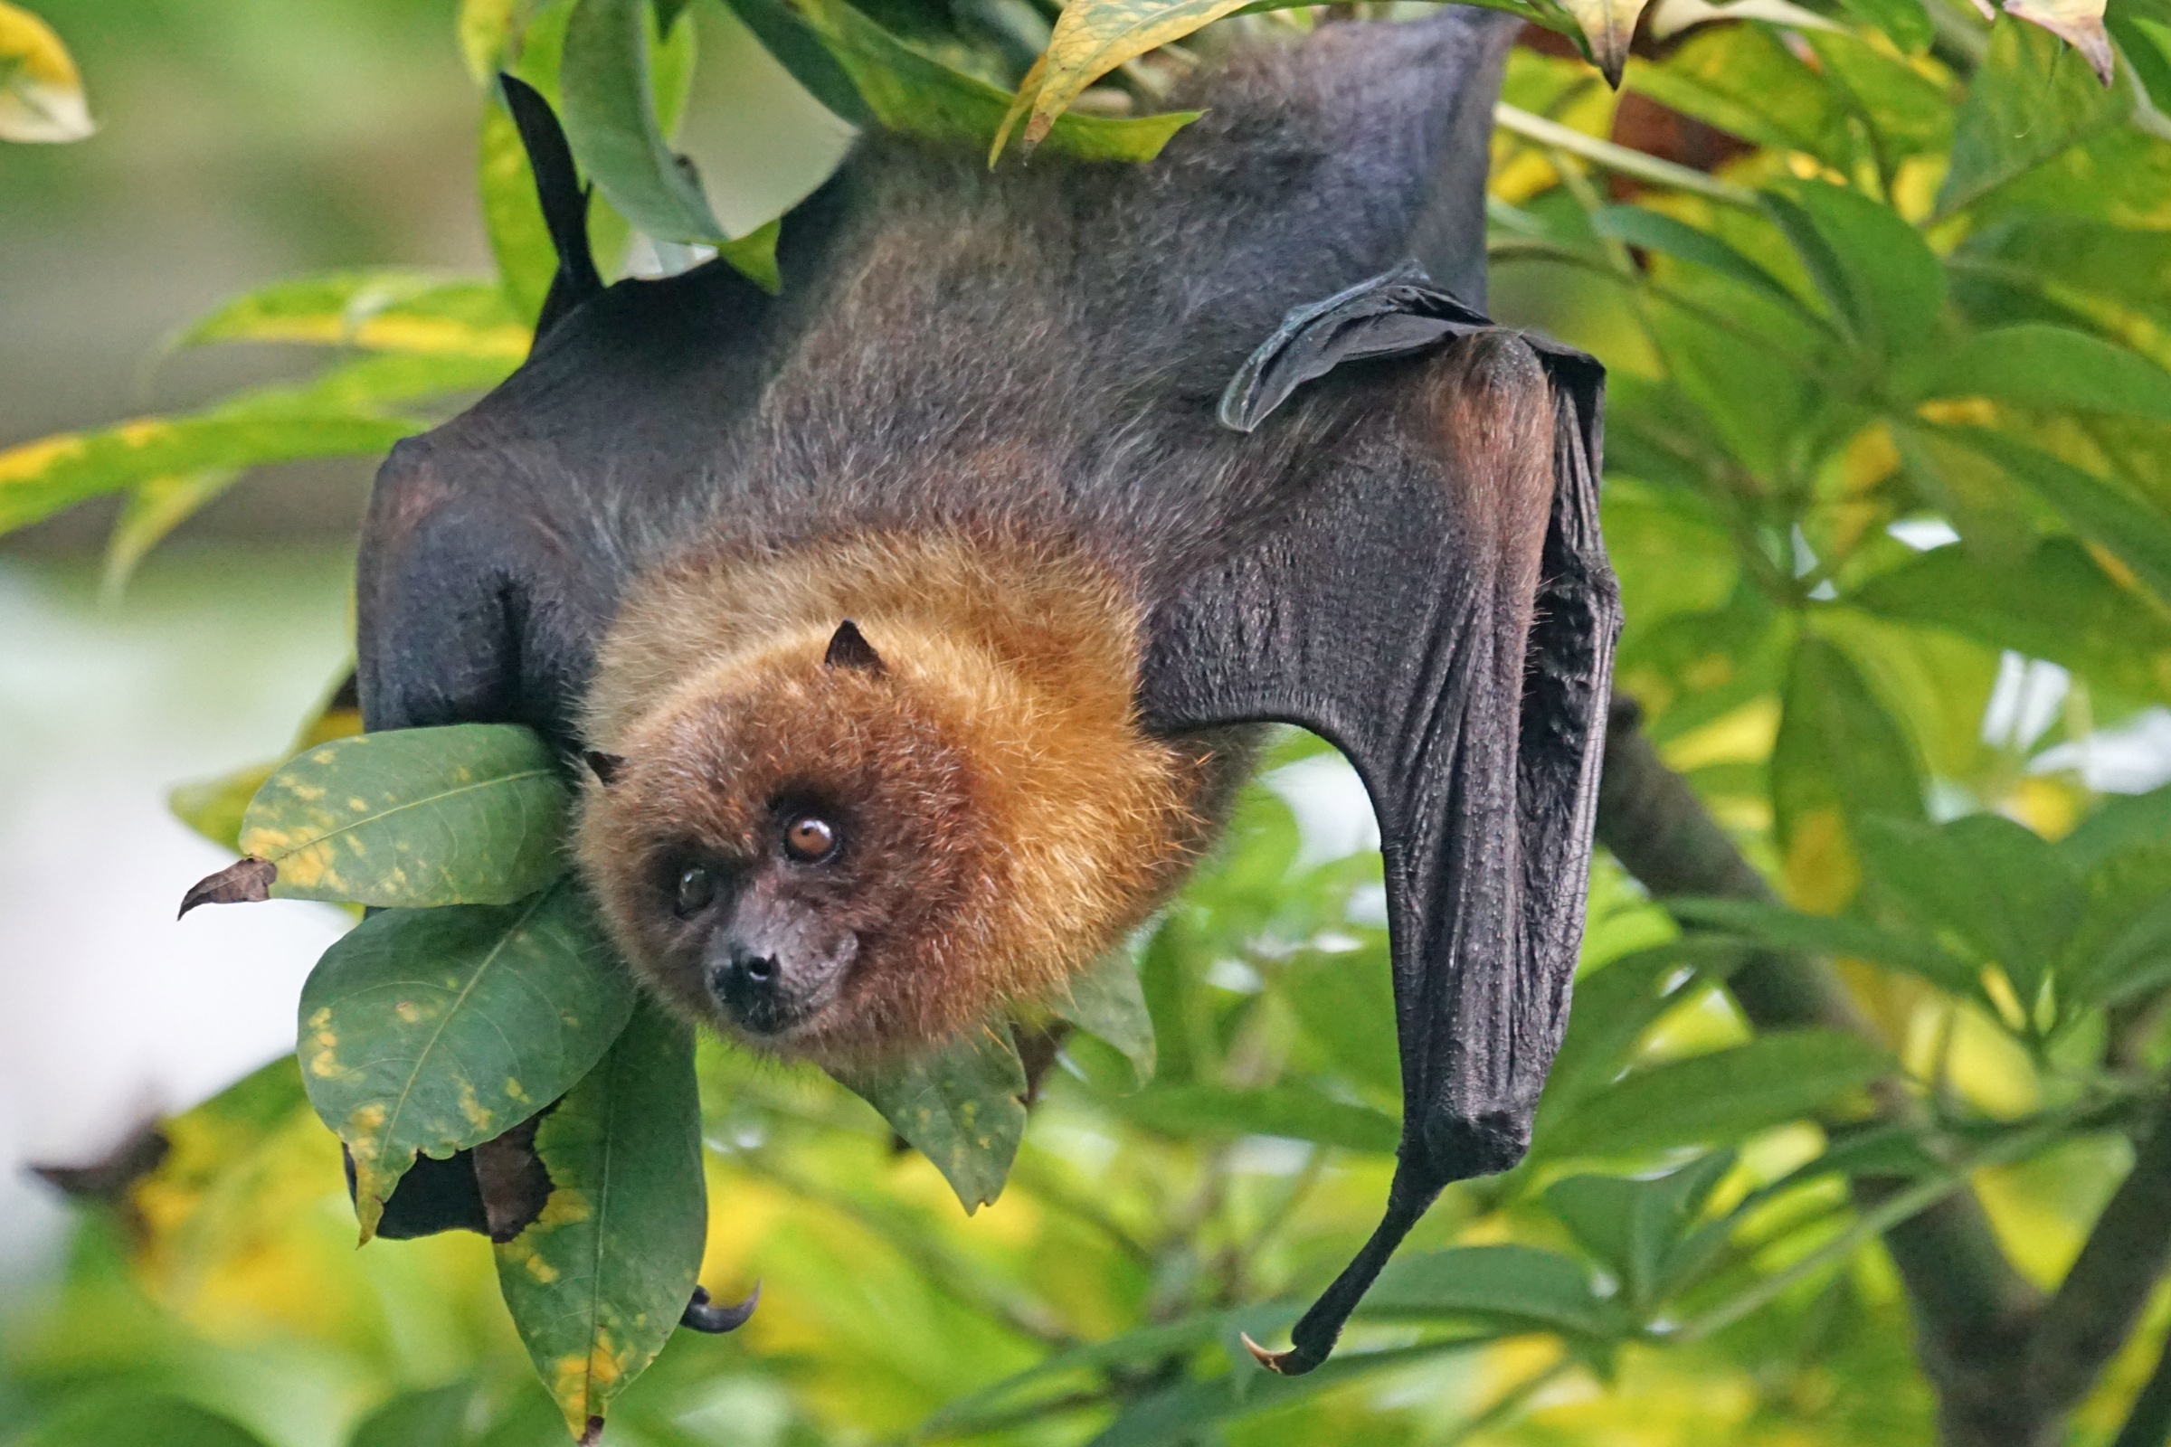
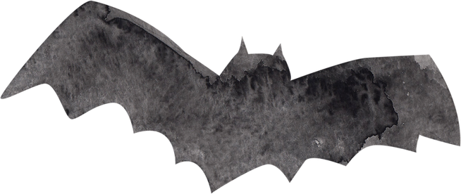


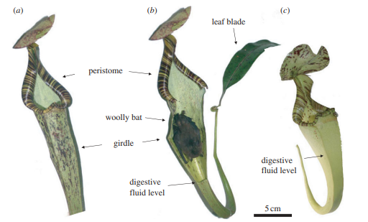
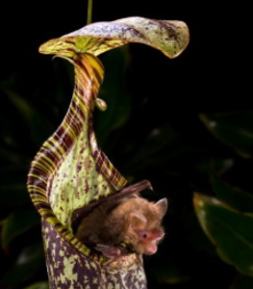
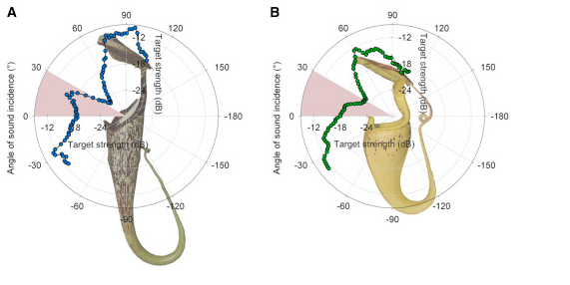
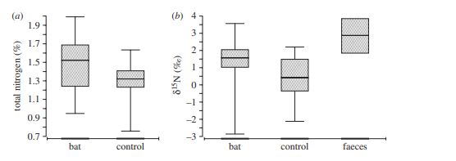

A Novel Resource-Service Mutualism Between Bats and Pitcher Plants
Authors
T. Ulmar Grafe1,*, Caroline R. Schoner2, Gerald Kerth3, Anissa Junaidi1 and Michael G. Schoner2
Affiliations
1Department of Biology, University Brunei Darussalam, Tungku Link, Gadong 1410, Brunei Darussalam
2Department of Animal Ecology and Tropical Biology, University of
Wurzburg, Biozentrum, Am Hubland, 97074 Wurzburg, Germany
3Zoological Institute and Museum, Greifswald University, JohannSebastian-Bach-Strasse 11/12, 17489 Greifswald, Germany
*Author for correspondence (grafe@biozentrum.uni-wuerzburg.de).
  Introduction
  Nepenthes, one of the carnivorous pitcher plants, genus grows in nutrient-poor soils and to acquire sufficient nitrogen depends on trapping arthropods
  The study investigates the mutualistic relationship between Nepenthes rafflesiana (pitcher plant) and Kerivoula hardwickii hardwickiip (woolly bats)
  The study hypothesizes that a mutualistic relationship exists between N. r. elongata and Hardwicke's woolly bats because the bats take shelter in the plant and discharges wastes while the plants get the supply of nitrogen from the waste of bats
  This process indicates the uncommon mutualism where N. r. elongata gets nitrogen from the waste of Hardwicke's woolly bats
  Methods
  Results
  The research was conducted during the time period from June 14 to July 30, 2009 in peat swamp forest, Brunei
  Daily patrols of 423 pitchers of N. r. elongata caught Hardwicke's woolly bats
  In order to track the movement, the radio transmitters were used
  We conducted an isotopic analysis of the collected data to calculate the content of nitrogen in the pitchers used as roosts (N= 38)and compared it with the pitchers that were not occupied (N= 17)
  We used a two-member isotopic mixing model to estimate the total foliar nitrogen from bats
  Our study found that during 6.5 weeks, 87 of 418 (20.8%) N. r. elongata pitchers had been occupied by 25 Hardwicke' woolly bats
  N. r. elongata offered ample room to roost for bats and there were reduced fluid levels, however, N. r. typica aerial pitchers provided less roosting space as they were not occupied by bats
  The isotopic analysis informed that 33.8% of foliar nitrogen was collected from woolly bat faeces
  Discussion
  The findings of the study are significant and inform about resource-service mutualism between carnivorous plants and animal waste
  N. r. elongata offers reduced fluids and secure roosting space to Hardwicke's woolly bats
  The win-win situation for both animals and plants seems advantageous in the context of a nutrient-poor environment and reflects the ecological strategy
Figure 1: An illustration of an N. r. elongate and different labeled parts. (a) The N. r. elongata aerial pitcher (b) The same aerial pitcher with an inside view of bat roosting due to front tissue removal (c) Aerial pitcher of N. r. typica that has different fluid levels compared to N. r. elongata
Figure 3: Bats are attracted acoustically to mutualistic carnivorous plants (A) The illustration of echo reflectance of Nepenthes hemsleyana. The red areas indicate where typically bats approach (From 0 degrees to 30 degrees). (B) The illustration of echo reflectance of Nepenthes rafflesiana. The red areas indicates where typically bats approach (From 0 degrees to 30 degrees). The sound effect of Nepenthes hemsleyana is stronger than that of Nepenthes rafflesiana.
Figure 2: Win-win. A closeup view of a bat preparing to roost inside the pitcher
  Conclusion
  References
Our study expands the knowledge that bats are beneficial for pitcher plants and offer good nitrogen sources to pitcher plants. The findings of the paper offer new insights into mutualism between plants and animals. 33.8% of nitrogen from faeces of bats seem a good amount for N. r. elongata.
  Jones, G. (2015). Sensory Biology: Acoustic Reflectors Attract Bats to Roost in Pitcher Plants. Current Biology, 25(14), R609-R610. http://dx.doi.org/10.1016/j.cub.2015.06.004
  Grafe TU, Schöner CR, Kerth G, Junaidi A, Schöner MG. A novel resource-service mutualism between bats and pitcher plants. Biol Lett. 2011 Jun 23;7(3):436-9. http://doi.org/10.1098/rsbl.2010.1141
  Schöner, M. G., Schöner, C. R., Simon, R., Grafe, T. U., Puechmaille, S. J., Ji, L. L., & Kerth, G. (2015). Bats are acoustically attracted to mutualistic carnivorous plants. Current Biology, 25(14), 1911-1916.https://doi.org/10.1016/j.cub.2015.05.054
Figure 4: Data of the collected nitrogen during the analysis of collected samples (a) Box-plot illustrates the nitrogen quantity in occupied and unoccupied pitchers (b) Box-plot illustrates foliar d15N of pitchers both in occupied and unoccupied ones and highlights bat faeces. On average, 33.8% of foliar nitrogen came from Hardwicke' woolly bats' faeces. The level of nitrogen is higher in the occupied pitcher compared to unoccupied ones

