Slide 1



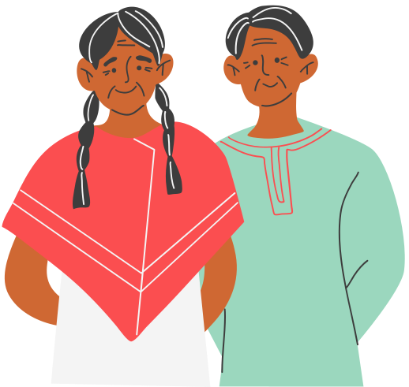

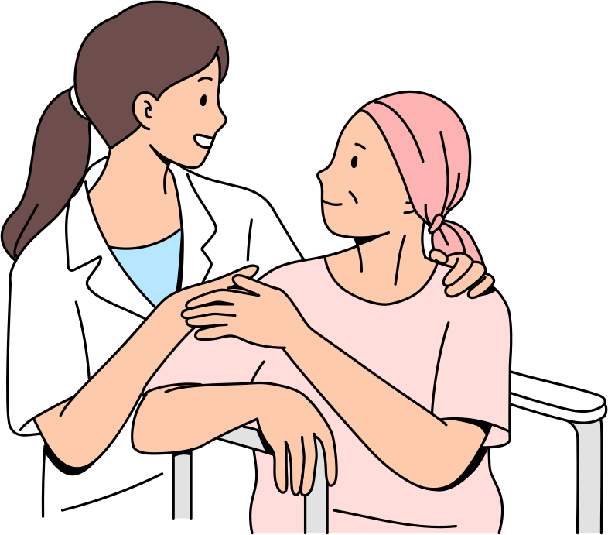

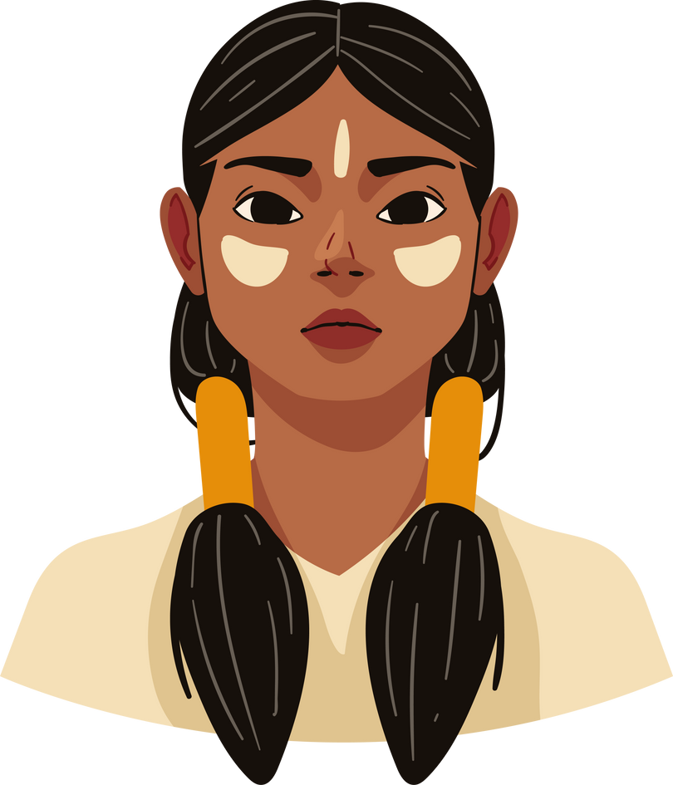

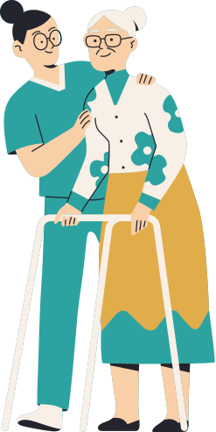

Digital Learning Portfolio
Reasons to Choose Nursing Path
For me, nursing is not just a profession but rather it is a call for humanity. I chose the nursing profession because I want to improve the illness experience of individuals and seek to provide patient-centered and compassionate care. In the past few years, I have earned experience and developed skills in personal care, empathetic communication, and mobility assistance. I aim to use these skills to offer holistic care to the patients while promoting their dignity and autonomy.
Honesty Module
The Grandfather's teaching of Honesty emphasizes trustfulness, openness, transparency, and integrity. In order to reconcile with Indigenous people and support them in their healing journey, we must acknowledge past injustices (Certificate Attached Below)
Reflection and Learning (Honesty)
  One of the significant points in the module I learned is the understanding that reclaiming land is an integral part of reconciliation. Thus, in my professional practice, I will recognize as well as validate the colonial oppression and integrate this learning into patient-centered care. I will be vocal about the land rights of Indigenous people and understand the unique circumstances of Indigenous patients.
  Another thing I learned is that we are all treaty people in Ontario. This understanding reminds me that I have a shared responsibility towards my Indigenous patients. Thus, I have to foster trust in the healthcare setting with Indigenous patients and advocate for their equal accessibility to healthcare resources.
Respect Module
The Grandfather's teaching of Respect emphasizes honoring others' cultural backgrounds and identities. This aspect is crucial in the healthcare setting to offer culturally safe and inclusive care to the Indigenous people (Certificate Attached Below).
Reflection and Learning (Respect)
  One of the significant points I learned in this module is the importance of reclaiming names. In order to respect Indigenous identities we need to acknowledge that names hold value for them. In my professional practice, appreciation of the cultural heritage of Indigenous patients and creating a respectful environment where their culture and identities are welcomed and respected are the keys to reconciliation.
  I also learned about the importance of language in reconciliation. This learning is important for my professional practice in terms of developing therapeutic and clear communication with Indigenous patients. I need to be mindful of language and ensure that Indigenous patients are heard and respected within the healthcare setting.

Slide 2

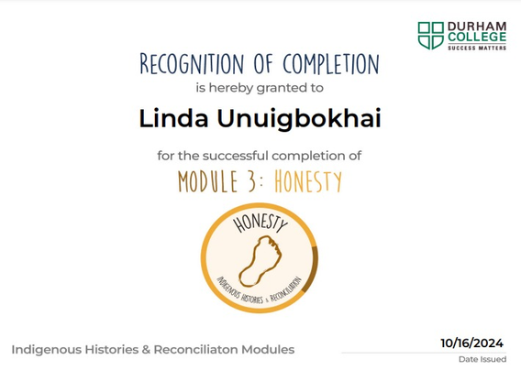

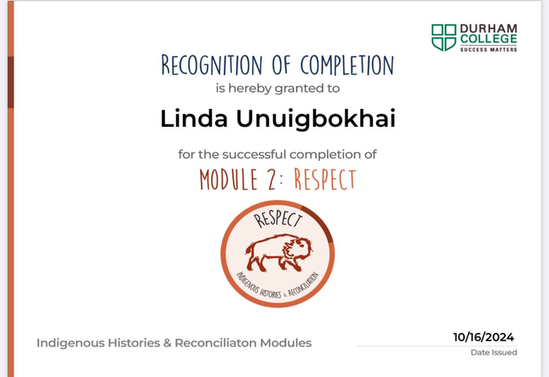

Conclusion
  The modules (Honesty and Respect) have expanded my knowledge and encouraged me to offer respectful and culturally safe care to Indigenous patients. I will acknowledge colonial oppression and past wrongdoings, honor the unique experiences and identities of my Indigenous, and build trusting relationships with them through inclusive and quality care. I will offer patient-centered, holistic, and compassionate care and promote mutual respect in my all interactions with patients.
Certificate (Honesty)
Certificate (Respect)
References
Durham College (n.d). Honesty Module. Indigenous Histories and Reconciliation
Durham College (n.d). Respect Module. Indigenous Histories and Reconciliation

